Slide 1
Day 2

Slide 2









Map
Create ARDs for:
AE Table
PFTs Summary
Stats Analysis
Mocks
ARDs
Plan
ADaMs
Outputs

Slide 3

Rules of ARDs
Analysis Results Datasets (ARDs) have a few key features
1 unformatted value per row
Distinct columns for each grouping variable
Include everything you want to display (particularly labels)
Why?
Keeping 1 unrounded value per row means we can change rounding without rerunning the analysis
Distinct columns for each group give maximum flexibility of the look of the final table (e.g. treatment could be a group or it could go into the columns across the top)
{tfrmt} only takes one dataset in so everything needs to be in it

Slide 4






A Note About ARDs
QC is done on raw value
Yeah!
You don’t have to waste time trying to match formatting to match QC
But…
QC will be more sensitive to floating point
How do we define “wrong”/ “incorrect”
Context will be needed to create levels of difference tolerance for QC

Slide 5
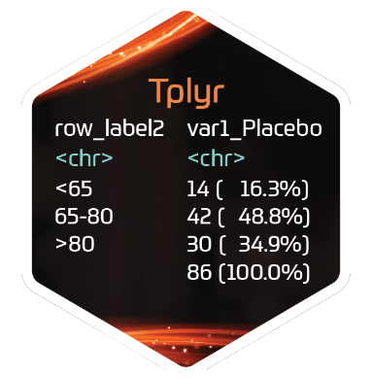



Descriptive statistics
{Tplyr} works by layering groups of descriptive statistics
Each layer has two basic flavours:
group_count()
group_desc()
Within the layer function add additional specifications such as:
Statistics to calculate
Distinct counts
 |  | Placebo | Treatment | Total
Age (y) | n | 15 | 13 | 28
 | Mean (sd) | 73.6(9.35) | 74.2(7.23) | 71.8(8.29)
Sex | n | 14 | 13 | 27
 | Male | 8 (57.1%) | 7 (53.8%) | 15 (55.6%)
 | Female | 6 (48.2%) | 6 (46.1%) | 12 (44.4%)

Slide 6
{Tplyr}
General Purpose:
Building an ARD from an ADAM for standard descriptive statistics
Lifecycle:
It is on CRAN and has been around for ~2 years. Fairly stable, but new features are still being added
Common Functions:
tplyr_table()
Setup a table
add_layer()
Adds a layer to build descriptive stats on
group_count()
Calculates count based descriptive stats
group_desc()
Calculates continuous descriptive stats
add_total_group()
Adds totals column
get_numeric_data()
Pulls out an ARD from a Tplyr table
set_distinct_by()
Sets how to count distinct subjects
https://atorus-research.github.io/Tplyr/

Slide 7

Demo time
Notes:
Go through each set in the process flow when building a pfts dataset

Slide 8
Exercise 5: Creating ARDs
Add layers for ethnicity and baseline BMI to the demography table
Calculate the number and percentage of unique subjects with at least one AE by AEBODSYS, AETERM, and treatment
Calculate the number and percentage of *unique* subjects with any AE by adding an additional count layer to the code from 5B. Also add a total treatment group.
For the safety population, calculate descriptive statistics for each pulmonary function tests at each visit and each treatment
Get the same descriptive statistics as in (D) for the change from baseline of each pulmonary function test by visit and treatment

Slide 9
Math warning
Notes:
Tplyr was designed for descriptive tables
Computations + tidying together in 1 step
But what about more statistical tables (i.e. for primary/secondary analysis)?
May be model-based
Variety of terms, adjustments, thresholds, tests, etc.
Handling of missingness, convergence

Slide 10

Statistical Tables process flow
Step 1: Computations
Custom model code
Step 2: Extract & Tidy
Leverage existing packages
{nlme}
Build & run MMRM model
Extract estimates from model
Tidy results
{emmeans}

Slide 11
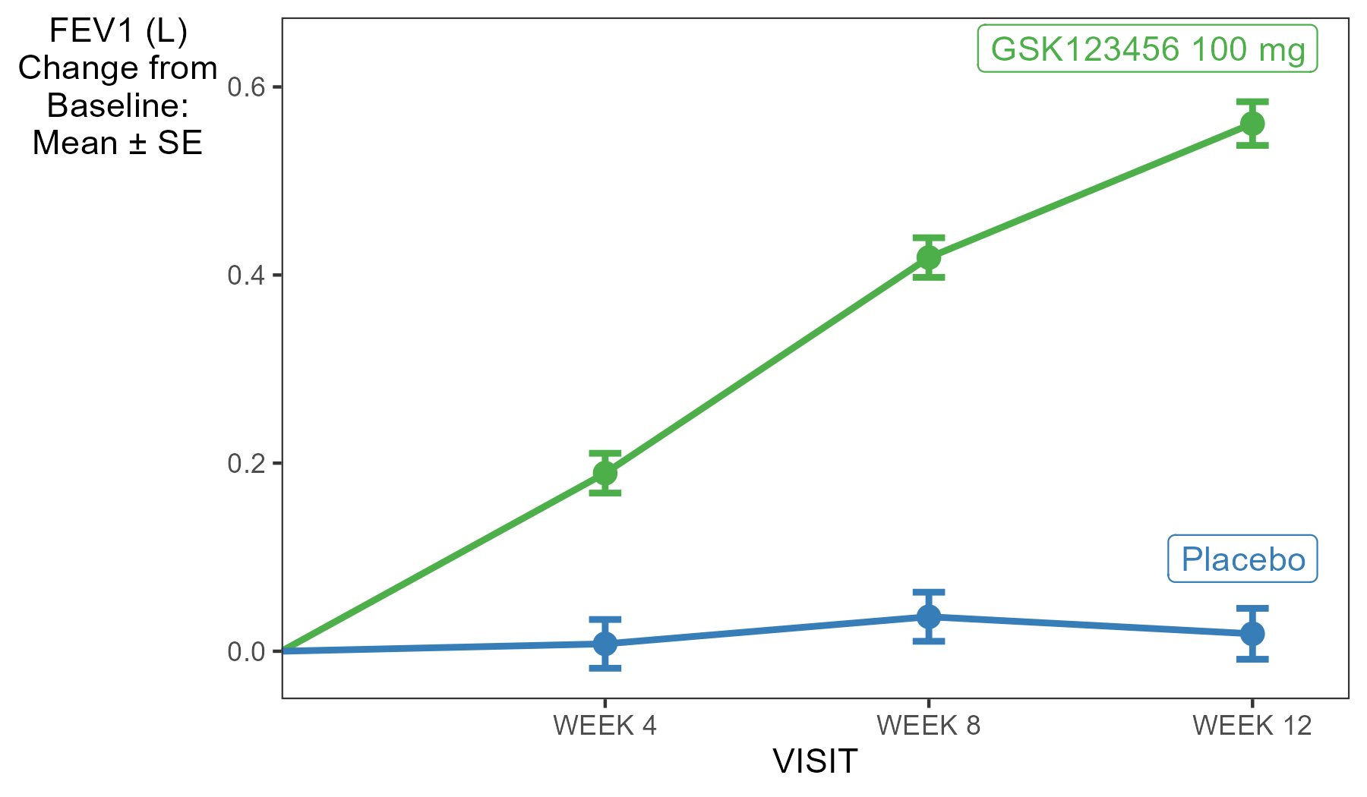
Primary Analysis
Does FEV1 change from baseline differ by treatment?
Notes:
2 Treatment groups:
GSK123456 100 mg
Placebo
If our drug is effective, it will improve lung function
FEV1 will increase for treated

Slide 12
Primary Analysis
Does FEV1 change from baseline differ by treatment?
Within-treatment change
Difference
Notes:
Questions to be answered
How much did FEV1 change over time within each group?
Is the change in FEV1 significantly different between the groups?
Repeat for each visit

Slide 13
Primary Analysis
Does FEV1 change from baseline differ by treatment?
Step 1: Computations
Custom model code
Step 2: Extract & Tidy
Leverage existing packages
{nlme}
Build & run
MMRM:
Mixed Model for Repeated Measures

Slide 14
Primary Analysis
MMRM: Mixed Model for Repeated Measures using nlme::gls
gls(
CHG ~
BASE +
TRTA +
VISIT +
BASE:VISIT +
TRTA:VISIT +
[correlation = …,
wights = …]
data = adpft
)
Outcome: Change from baseline
Account for any difference in baseline value
Treatment group
Study visit
Interaction: CHG by BASE to vary over time
Interaction: CHG by TRTA to vary over time
Unstructured covariance matrix
https://thestatsgeek.com/2020/12/30/mixed-model-repeated-measures-mmrm-in-stata-sas-and-r/

Slide 15
Primary Analysis
Does FEV1 change from baseline differ by treatment?
Step 1: Computations
Custom model code
Step 2: Extract & Tidy
Leverage existing packages
{nlme}
Build & run MMRM model
Extract estimates from model
Tidy results
{emmeans}
YOUR
TURN

Slide 16
Exercise 6: Convert stats analysis into an ARD
Using `emm`, extract the lsmeans and standard errors to make a long and skinny dataset where there is one numeric value per row
Use the `tidy()` function to turn the emmeans output (`emm`) into a dataset
Create a long and skinny dataset with only the estimate and standard error for each treatment and visit. (Note: it will be easier later if the name of the test goes to "param" and the value goes to "value")
Using `emm_diff`, extract the difference of the lsmeans, lower bound of 95% CI, upper bound of 95% CI, p-value to make a long and skinny dataset where there is one numeric value per row
Using `emm_diff`, extract the difference of the lsmeans, lower bound of 95% CI, upper bound of 95% CI, p-value to make a long and skinny dataset where there is one numeric value per row
Selecting the visit, contrast, lsmean, 95% CI and p-value, create a long and skinny dataset where there is one numeric value per row.
Combine the datasets from (A) and (B) to make an ARD with columns for visit, pfts label, treatment/treatment contrast label, value label, parameter, value, and order.

Slide 17
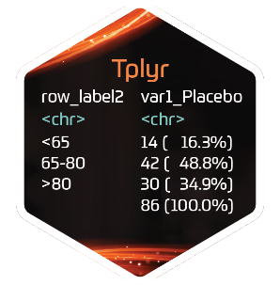
Map
Mocks
ARDs
Plan
ADaMs
Outputs
Create displays for:
AE Table
PFTs Summary
Stats Analysis

Slide 18

Demo time

Slide 19
Exercise 7: Make tables
Using the tfrmt code from exercise 2C and the AE ARD, make the AE tables (hint: you might need to change some parameters)
Using the tfrmt code from exercise 3A and the PFT ARD, make the summary of PTFs table.
Using the tfmrt code from 3B and the primary analysis ARD, create the final summary table

Slide 20



Map
Mocks
ARDs
Plan/Specs
ADaMs
Outputs

Slide 21





Comparison of current vs future process
Mocks
Current
Plan/Specs
ADaMs
Outputs
Mocks
ARDs
Proposed
Process
Plan/Specs
ADaMs
Outputs

Slide 22


Slide 23

Roadmap – Art of the Possible
Mocks
ARDs
Plan/Specs
ADaMs
Outputs

Slide 24

The Possibilities of Analysis Result Data
Analysis Results Data
Notes:
Must talk about one row per value that is the def of an ARD

Slide 25







The Possibilities of Analysis Result Data, {tfrmt}, and {ggplot2}
Analysis Results Data
Meta-analysis
Notes:
Must talk about one row per value that is the def of an ARD

Slide 26








Sharing Data for Tables & Figures
Tables
ARD’s
Figures
Notes:
Tables and Figures based on QC’d data
Lighter QC can be done on outputs

Slide 27
Sharing Data for Tables, Figures, Meta Analysis
Tables
Meta Analysis
ARD’s
Figures
Notes:
Tables and Figures based on QC’d data
Lighter QC can be done on outputs

Slide 28
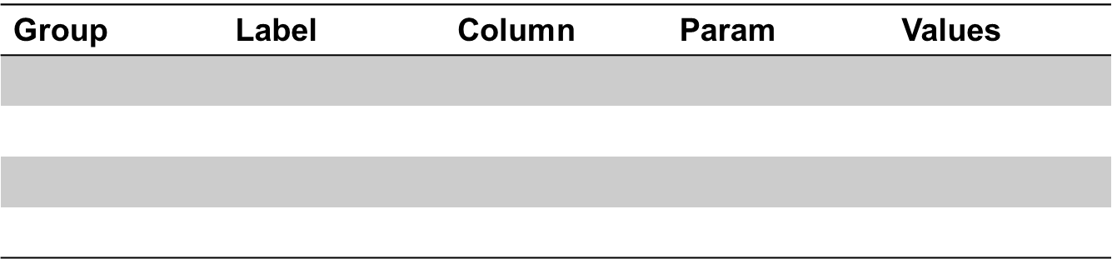
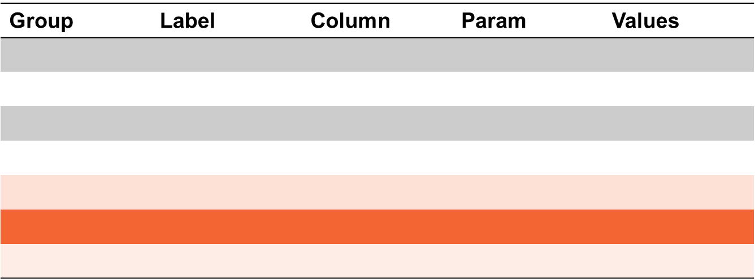
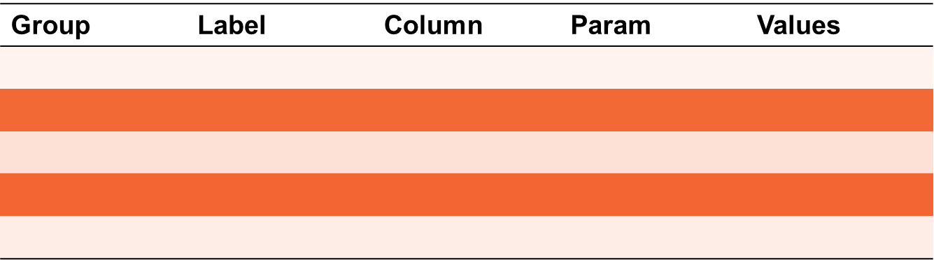
Combining Tables
Standardized params, labels, and groups allows for simple combinations
Filtering tables based on requests generates ARD subsets and do not need to be recalculated

Slide 29




Save Format Options
Submission tables
Analysis Results Data
Meta-analysis
Presentations
In-text Study Report
Integrated safety reporting
Notes:
Must talk about one row per value that is the def of an ARD

Slide 30
Styling Tables with {gt}
tfrmt outputs to gt tables
RStudio R Package
“Grammar of Tables”
tfrmt handles much of the “hard” stuff
Styles can be added to override our supplied formatting
EXAMPLE OF CUSTOMIZING gt STYLE WITH gtExtra

Slide 31
Saving gt to use Downstream
html
Presentations
In-text Study Reports
pdf
png
rtf
word
Presentations
Submission Tables
Presentations
Study Reports
Integrated Study Reports
Presentations
Submission Tables

Slide 32
Publication Outputs
Submission tables
Analysis Results Data
Meta-analysis
Presentations
In-text Study Report
Publications
Integrated safety reporting
Notes:
Must talk about one row per value that is the def of an ARD

Slide 33
Updating tfrmt’s
Layering tfrmt’s allows for updating parts of the tfrmt as needed
Post study and FDA Acceptance, journal and paper submission
Journals may require specific rounding for numbers and p-values

Slide 34
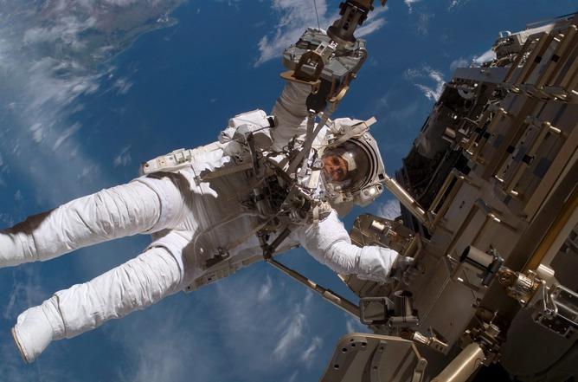
Demo Time
This Photo by Unknown Author is licensed under CC BY-ND

Slide 35
Interactivity and Dynamism
Submission tables
Analysis Results Data
Meta-analysis
Presentations
In-text Study Report
Dynamic Apps
Publications
Integrated safety reporting
Notes:
Must talk about one row per value that is the def of an ARD

Slide 36
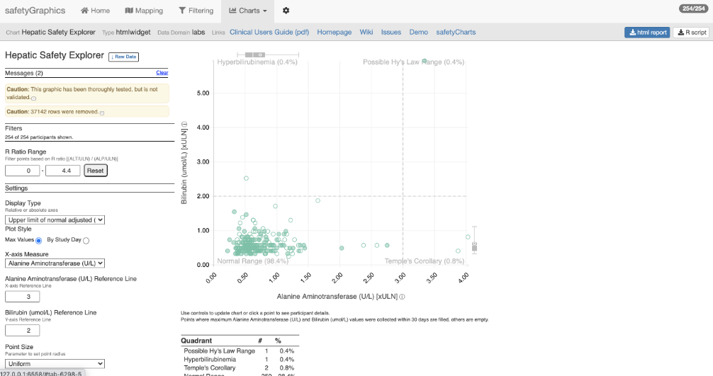
Shiny & Interactive Exploration
Tables formatting editable through a shiny app
Data inputs filterable by non-programmers
Easily preview and sort tables

Slide 37
Future of tfrmt
tfrmt to be saved as a JSON file
Tables as {ggplot} output to make it simpler to combine plots and tables
Explicit traceability between ARD and table

Slide 38
Future of tfrmt in your organization
Organizations define their ARDs can also provide tfrmt templates
Standardize how values are displayed across the org
Prevent programmer- differences
Mock shells based on a standard format that is shared
See {tfrmt} “templates” vignette

Slide 39
Exercise 8
Using the processed pft_tbl ARD, create a forest plot of Percent Predicted PEF (%) by visit
Using the tfrmt code from exercise 7C update the tfrmt to reflect the pvalue formatting and save the gt to a word document

Slide 40
reserve

Slide 41
Primary Analysis
MMRM: Mixed Model for Repeated Measures using lme4
lmer(
CHG ~
BASE +
TRTA +
VISIT +
BASE:VISIT +
TRTA:VISIT +
(0 + VISIT | USUBJID),
data = adpft
)
Outcome: Change from baseline
Account for any difference in baseline value
Treatment group
Study visit
Interaction: CHG by BASE to vary over time
Interaction: CHG by TRTA to vary over time
Random effect: allow slope to vary across subjects

Slide 42
Map
Mocks
ARDs
Plan/Specs
ADaMs
Outputs

Slide 43

How do I sell this internally?

Slide 44
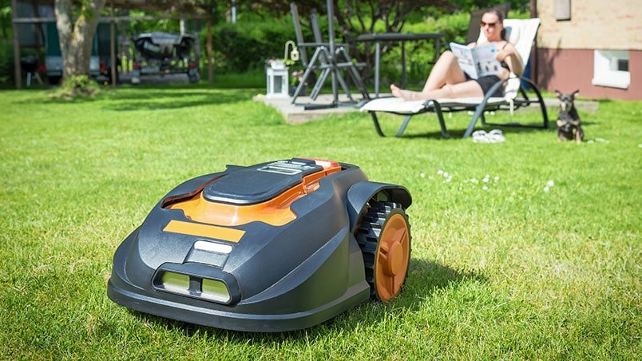
These tools save effort
Notes:
The current approach is time-consuming
Out workflow in pharma is pretty unique
We have a lot to do
This saves effort by making the routine bits easy
Formatting with tfrmt
BMI calculation

Slide 45
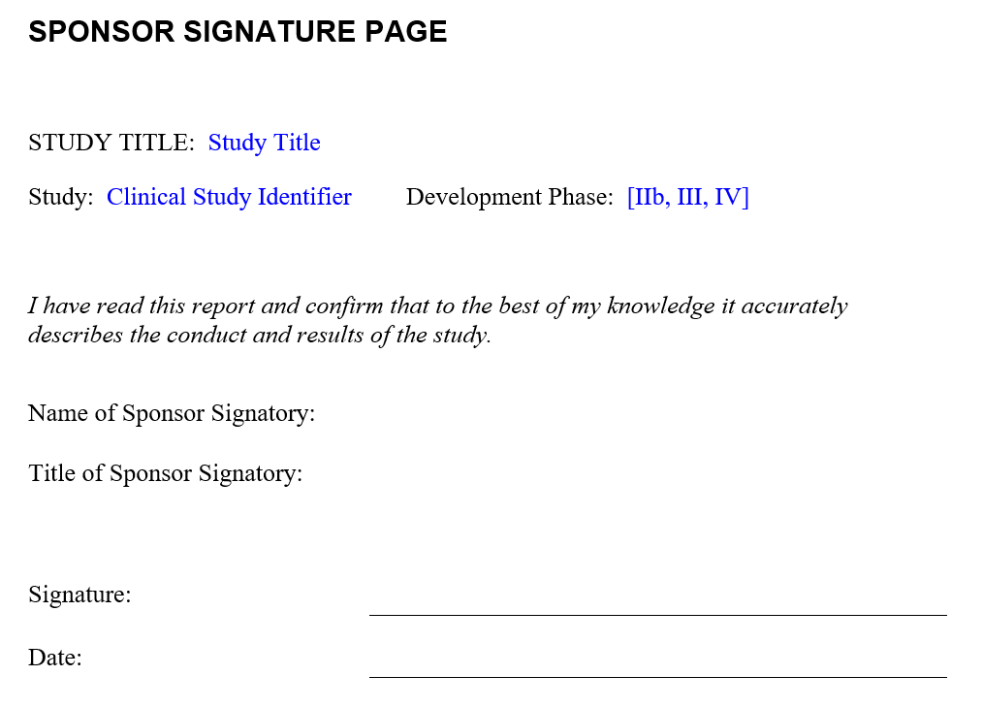


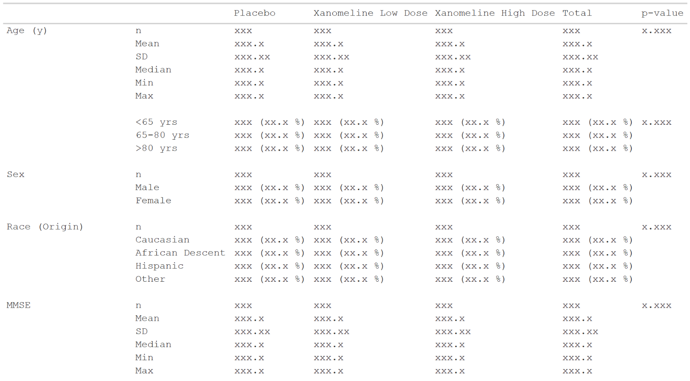

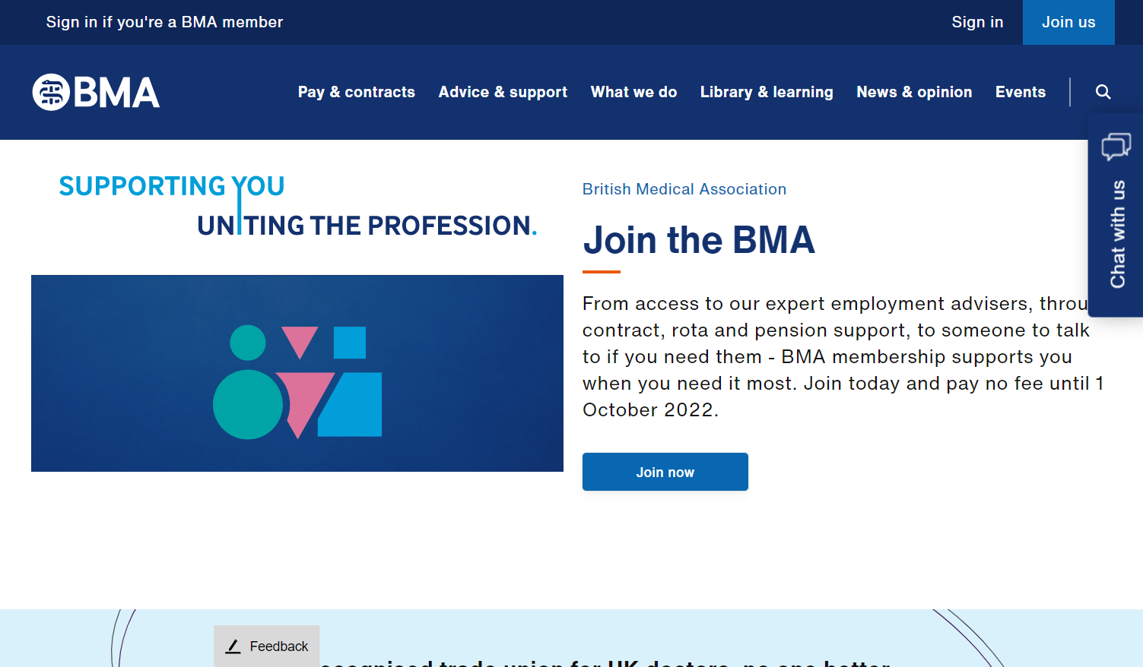
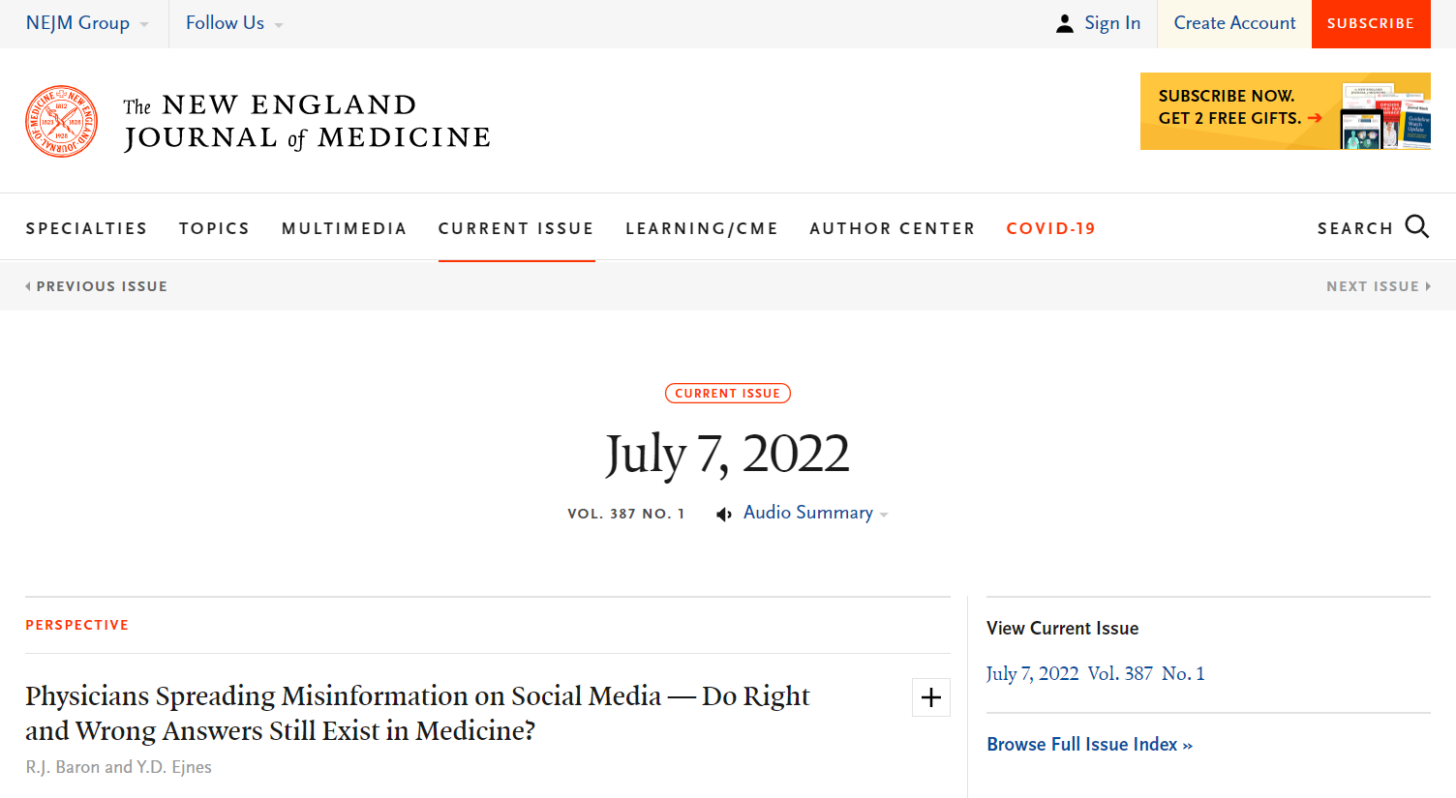
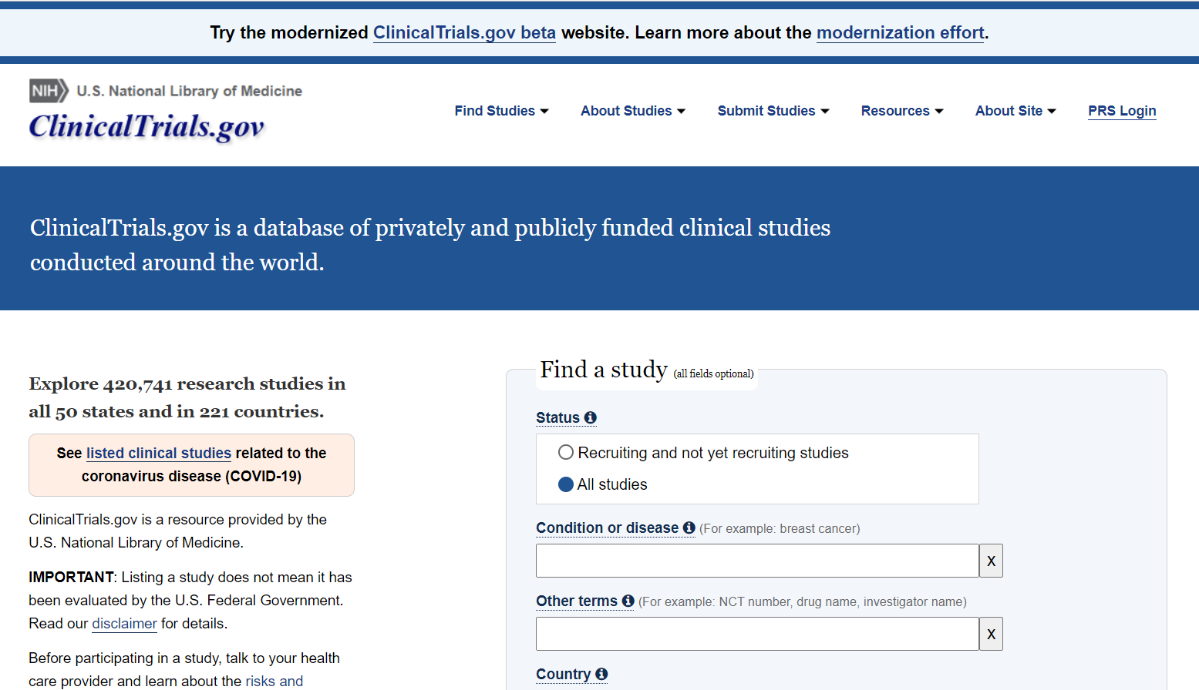
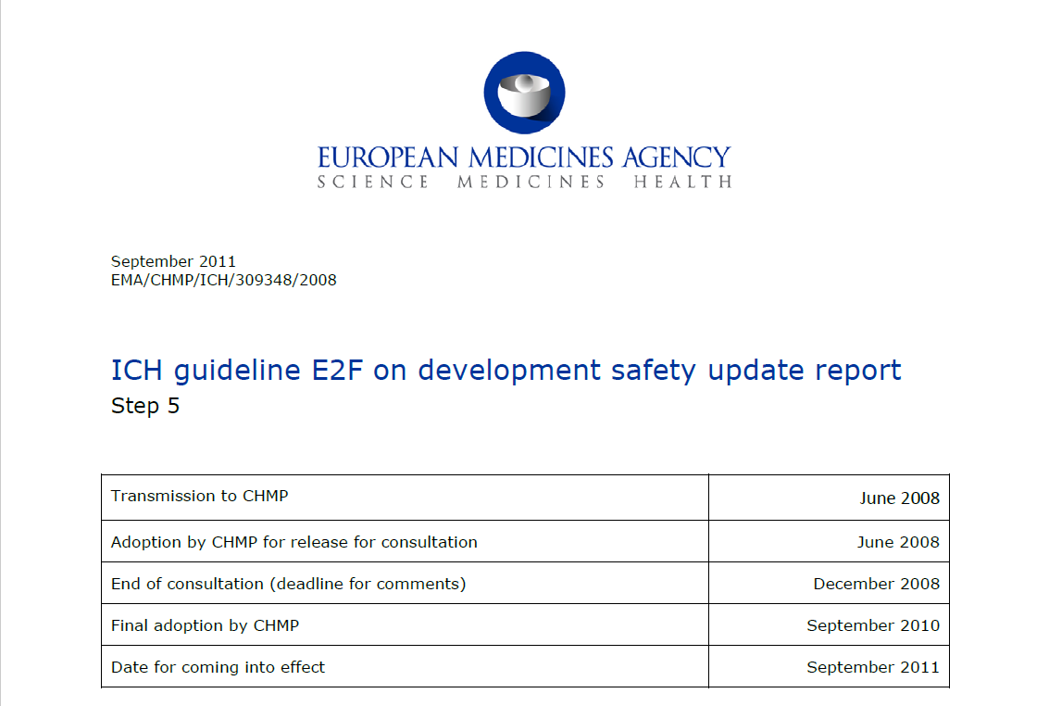
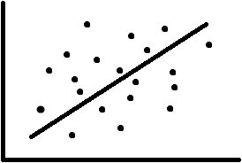
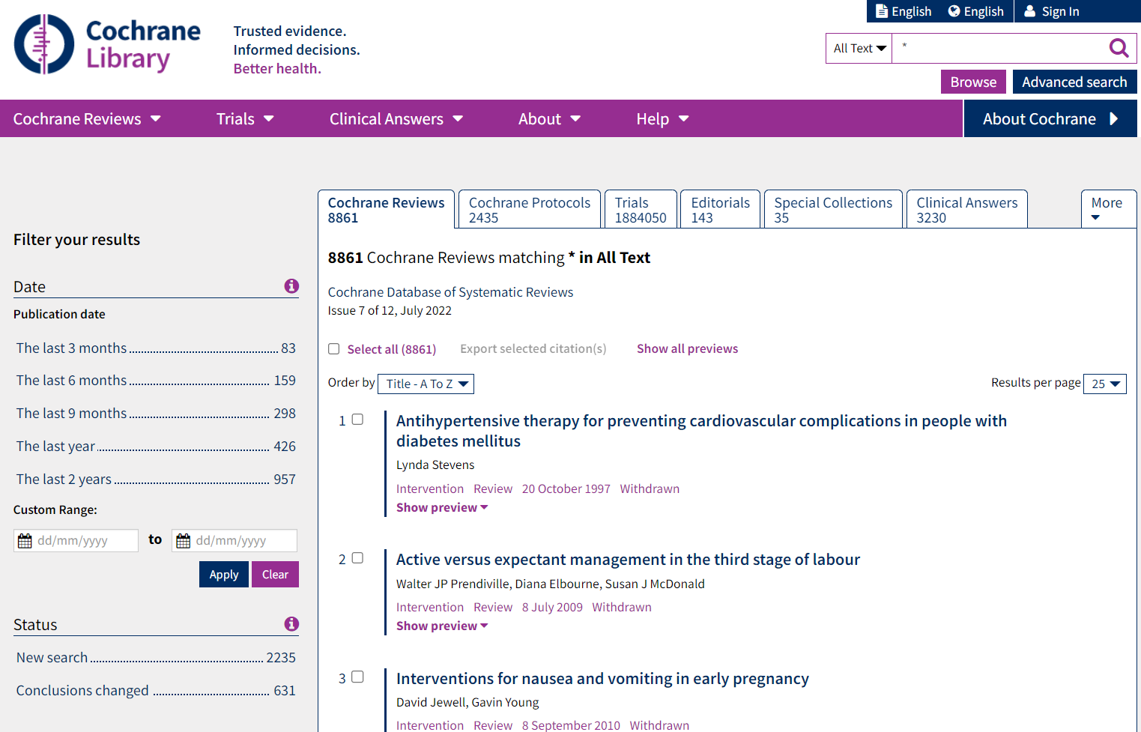
Analysis Results Data
The Possibilities
In-text CSR
Presentations
Submissions
Publications
Data Analysis
ADaM
Analysis Results Data
clinicaltrials.gov
In future, graphics?
Integrated safety reporting
Dynamic apps
Meta-analyses
Analysis
Formatting

Slide 46
Exercise 1b
Analysing Data
Now format your data from exercises 1 such that
The n and percentage are displayed as " [n] ([pct]%)"
The first percentage brace is aligned for each value
Blanks ("") are displayed instead of " 0 (0%)"
How much more would we learn about our data?
DOES NOT ADD VALUE!
Notes:
People should NOT ACTUALLY DO THIS
It is to illustrate that there’s a load of work to do that doesn’t add value

Slide 47
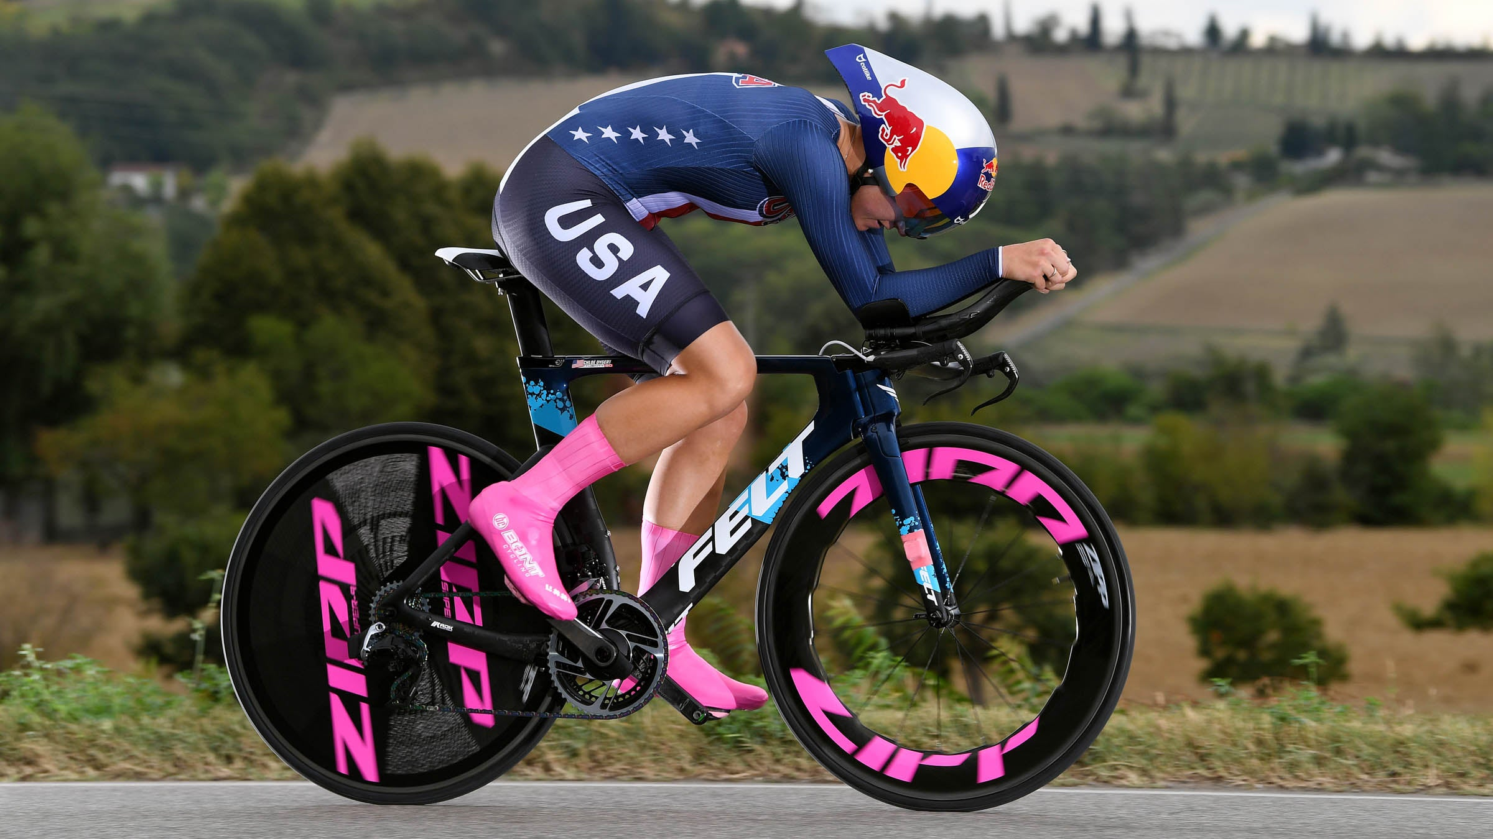
Reduction in Cycle time
Notes:
Formatting is now off critical path with tfrmt
We can plan up front

Slide 48

We’ll achieve more by working together

Slide 49

Tools are interchangeable
works with SAS

Slide 50
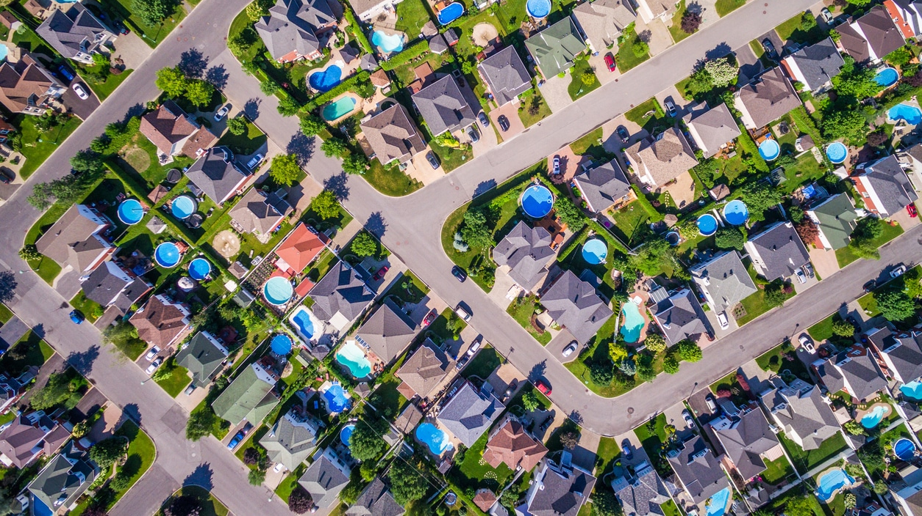
“Hey, look at what GSK are doing”

Slide 51

CDISC ARD’s is coming!

Slide 52

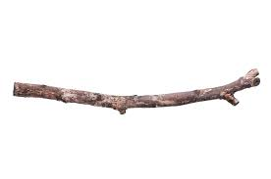
Value Proposition
Saves effort
Reduction in cycle time
Key tasks off critical path
We’ll achieve more by working together
Tools are interchangeable
GSK have committed to this
CDISC ARDs are coming

Slide 53
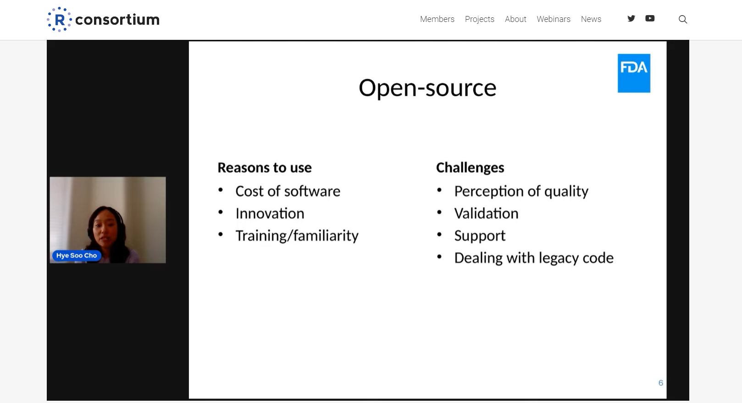
Why use R / Open source?
Using R in Regulatory Review Review experience of the R consortium submission pilot 1, Hye Soo Cho, FDA
NB: The presentation reflects the views of the author and should not be construed to represent FDA’s views or policies

Slide 54

Recap Quiz!
9 questions to help you:
Remember what you’ve been doing for two days
Sell these concepts internally
Candy on offer…
Notes:
9 because why not?!

Slide 55
Quiz
Name 5 potential destinations for Analysis Results Data [1pt for 4, 2pts for 5]
What {tfrmt} function defines the body of a table?
TRUE/FALSE? We require sample ARD in order to generate a mock gt object with {tfrmt}
TRUE/FALSE? We must know the output table structure before we can start our analysis
TRUE/FALSE? The {metatools} package holds the metadata used to build SDTM and ADaM datasets
What does `set_variable_labels()` in {metatools} do?
Notes:
Answers:
Submissions, In-text CSR, Presentation, Publications, clinicaltrials.gov, Dynamic apps, Meta-analyses, Integrated safety reporting, *Anything else that people come up with that seems plausible*
The body_plan function
FALSE. But it can help
FALSE. In this course we created mocks but this is not necessary. With ARD, knowing the table structure is not necessary
FALSE. That’s metacore
Adds labels to all columns per metadata definitions

Slide 56
Quiz
What does `set_variable_labels()` in metatools do?
With an ARD, should multiple Sgrouping variables be
Stacked in a single column
Spread over columns, one distinct column per grouping variable
TRUE/FALSE ARDs can be generated in SAS?
Name two output formats that {gt} can create
Notes:
Answers:
Submissions, In-text CSR, Presentation, Publications, clinicaltrials.gov, Dynamic apps, Meta-analyses, Integrated safety reporting, *Anything else that people come up with that seems plausible*
The body_plan function
FALSE. But it can help
FALSE. In this course we created mocks but this is not necessary. With ARD, knowing the table structure is not necessary
FALSE. That’s metacore
Adds labels to all columns per metadata definitions
B
TRUE
HTML, pdf, png, rtf, Word

Slide 57

Tie breaker
How many times does the word ‘derive’ appear on the Admiral manual [v0.7.0]?
Notes:
Answer: 997

Slide 58
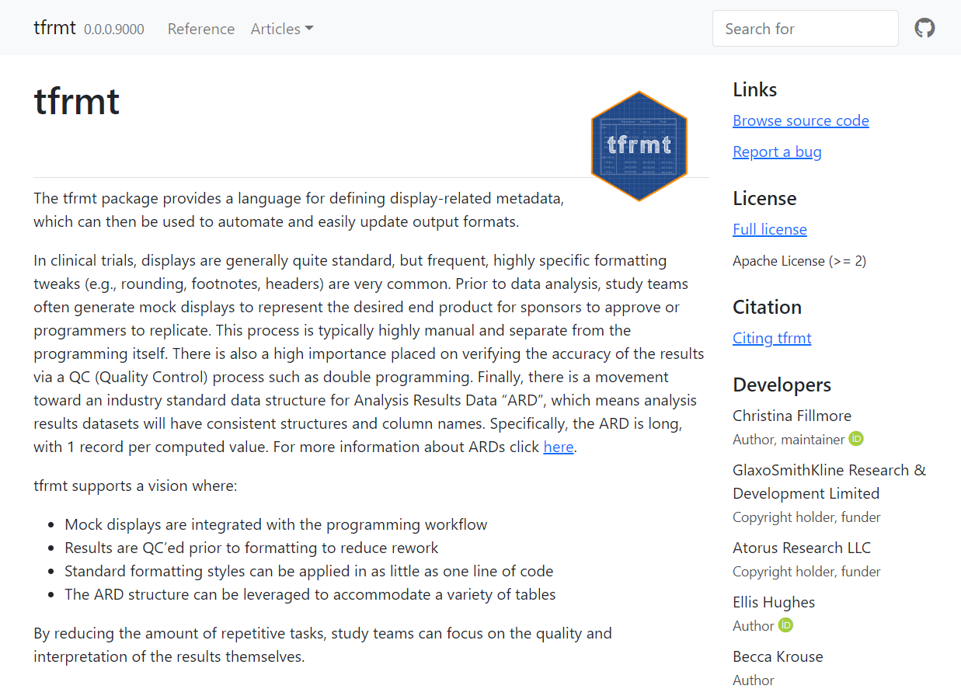

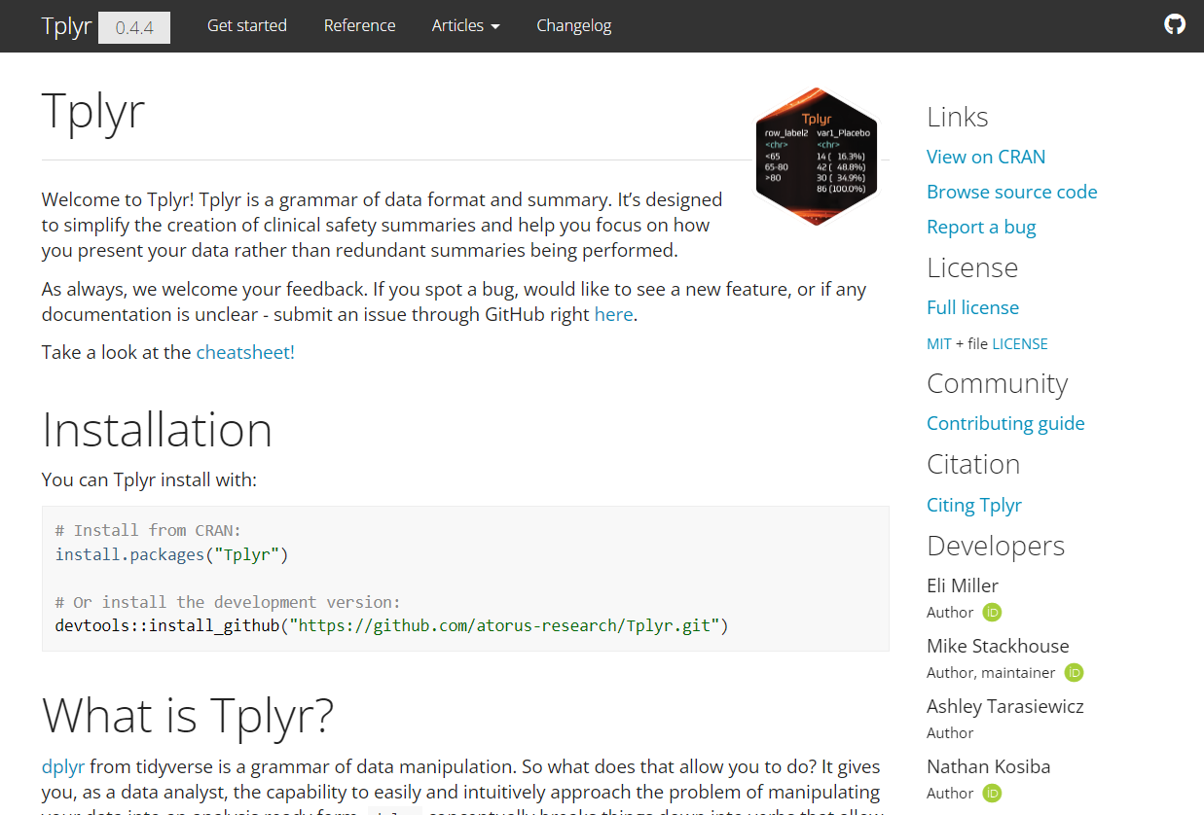
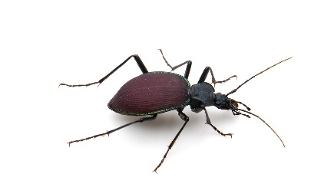

Can I help?
https://github.com/pharmaverse/
https://gsk-biostatistics.github.io/tfrmt/
https://github.com/atorus-research/Tplyr
https://github.com/atorus-research/metacore
https://github.com/pharmaverse/metatools

Slide 59

Thank you

